Slide 1
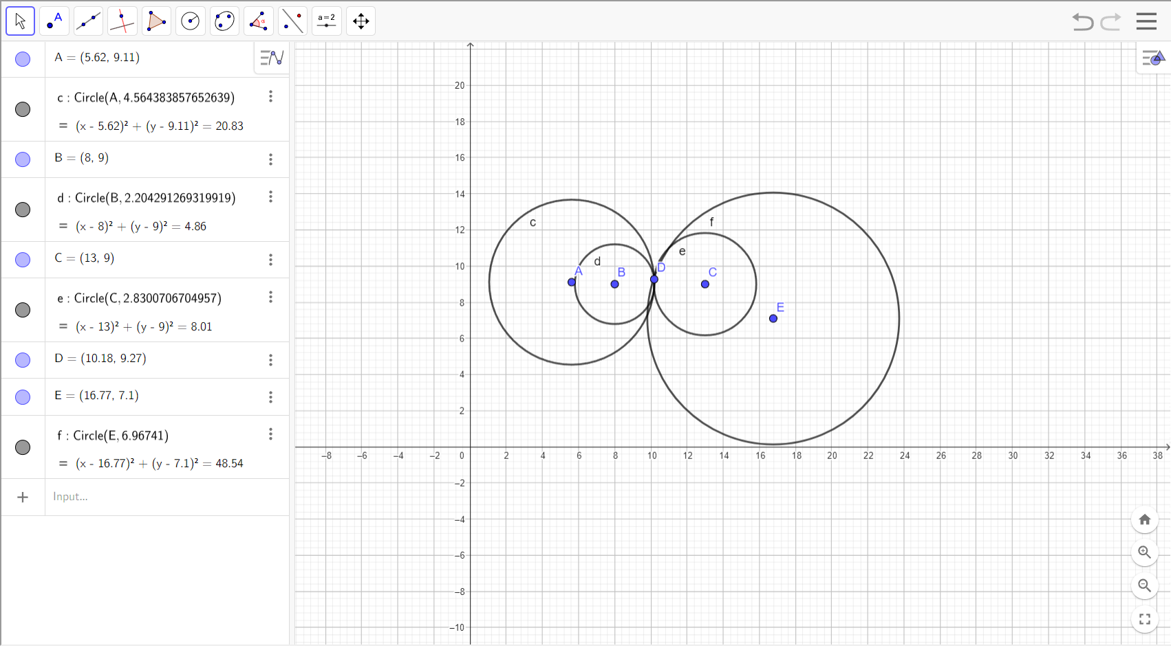
D is the Predictor
Multilateration result:
x = 10.180425597583532 ,
y = 9.343102083931125

Slide 2
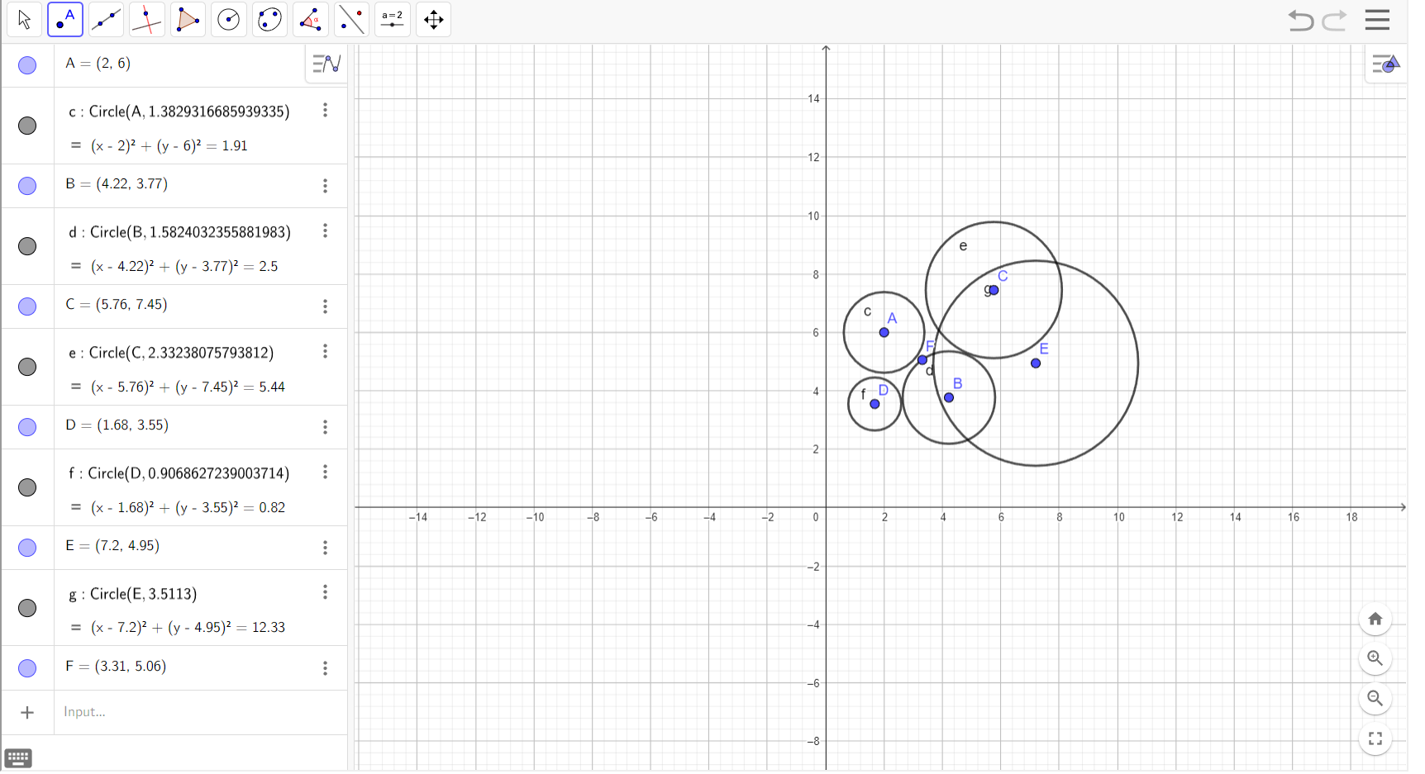
F is the Predictor
Multilateration result:
x = 3.3108245507897727 ,
y = 5.0575577658906905

